Slide 1
Sample standardization and resampling
Teaching Golems about measurement
Dr. Gregor Mathes

Slide 2

Sample standardisation
We want to compare species richness between two forests
Forest A has 4 species, forest B 2
However, sampling was much higher in forest A
How can we inform our Golems about the messy reality of data collection
Sampling effort and spatial bias
Locality A
Locality B
High sampling
intensity
Low sampling
intensity

Slide 3
Sample standardisation
Rarefaction
Sampling more individuals almost always yields more species
Downsample to equal number of sampled individuals
What is the expected number of species we would have found in forest A if we had stopped after 100 individuals?

Slide 4
Rarefaction
# Species
# Individuals

Slide 5
Exercise 4 - Rarefaction
Go through the 4_exercise_rarefaction.R script in the Github repository

Slide 6
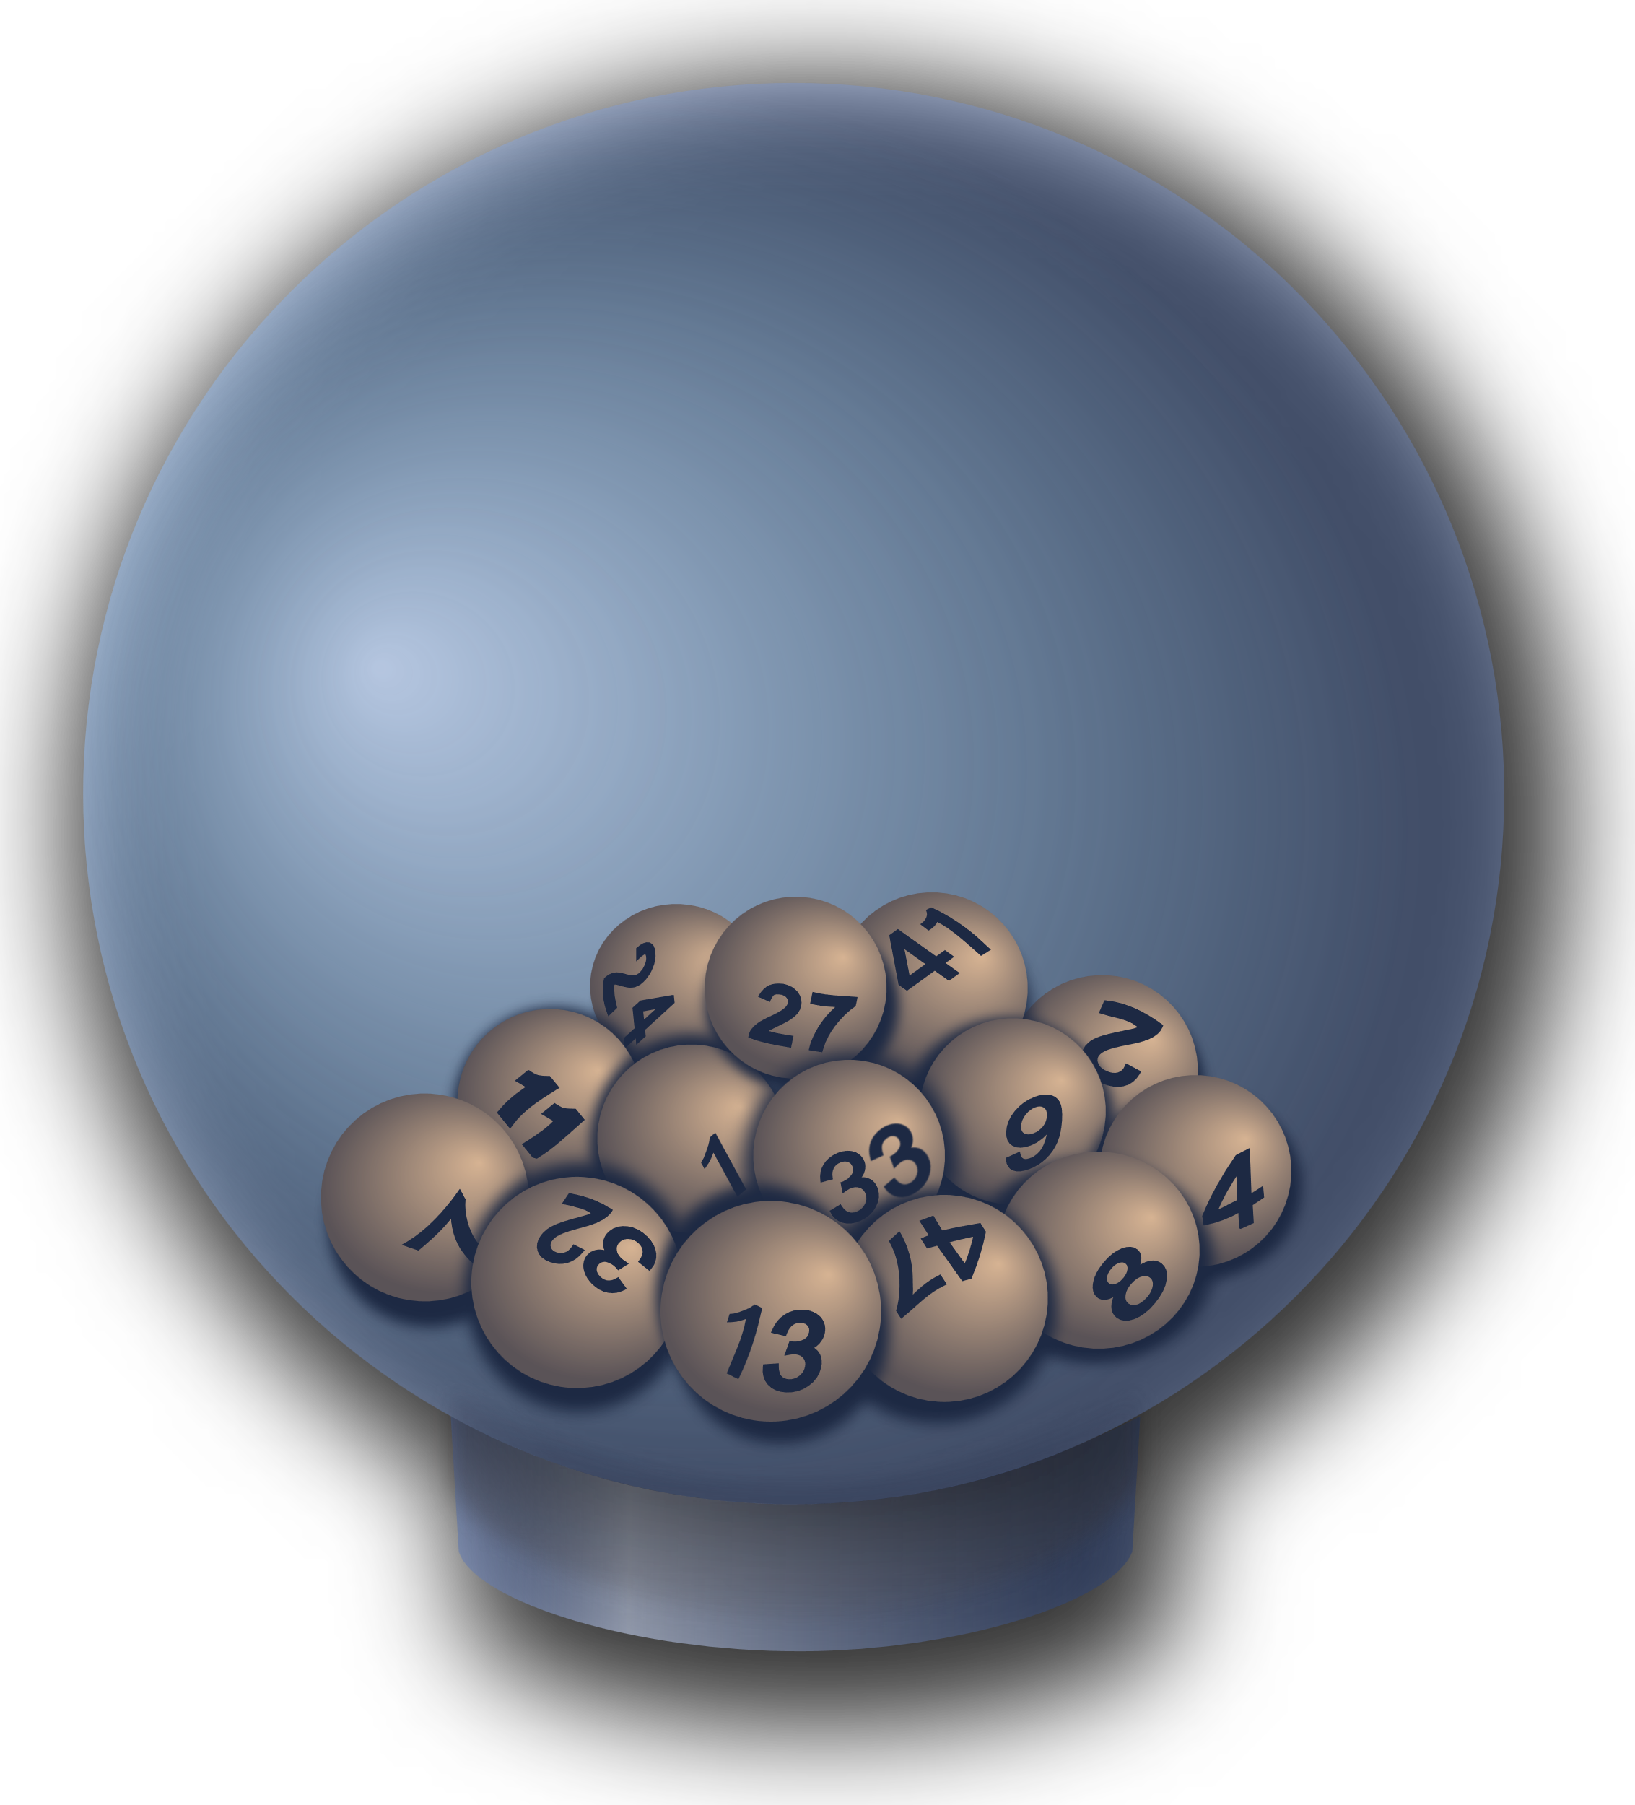
Bootstrapping
Simulate sampling to quantify uncertainty

Slide 7
Bootstrapping
Richness estimates can have large associated uncertainties
Comparing only the mean rarefied richness ignores this uncertainty
# Species
# Individuals

Slide 8
Bootstrapping
Bootstrapping is a Golem that allows us to simulate multiple sampling, thereby estimating uncertainty
What would our richness estimate look like when we sample the site again, and again, and again … ?
How to: Resample assemblages to the standardizing size with replacement and calculate species richness. Calculate mean and standard deviation from resamples and compare between sites

Slide 9
Exercise 5 - Bootstrapping
Go through the 5_exercise_bootstrapping.R script in the Github repository

Slide 10

Coverage based rarefaction
A better estimate for sampling effort

Slide 11
Coverage based rarefaction
Problem
Samples standardized by size will usually have different degrees of completeness, depending on the species–abundance distributions of the communities being compared
Temperate forest
Tropical forest

Slide 12
Coverage based rarefaction
Solution
Compare samples of equal completeness, not equal size. Use the proportion of the total species richness that is observed (coverage), i.e., how well the sample represents the community.
Rare species are less likely to be detected, so the method aims to correct for differences in how well-sampled each community is by focusing on the fraction of species observed
Chao & Jost, 2012
Chao et al., 2014
Hsieh, Ma & Chao, 2016

Slide 13
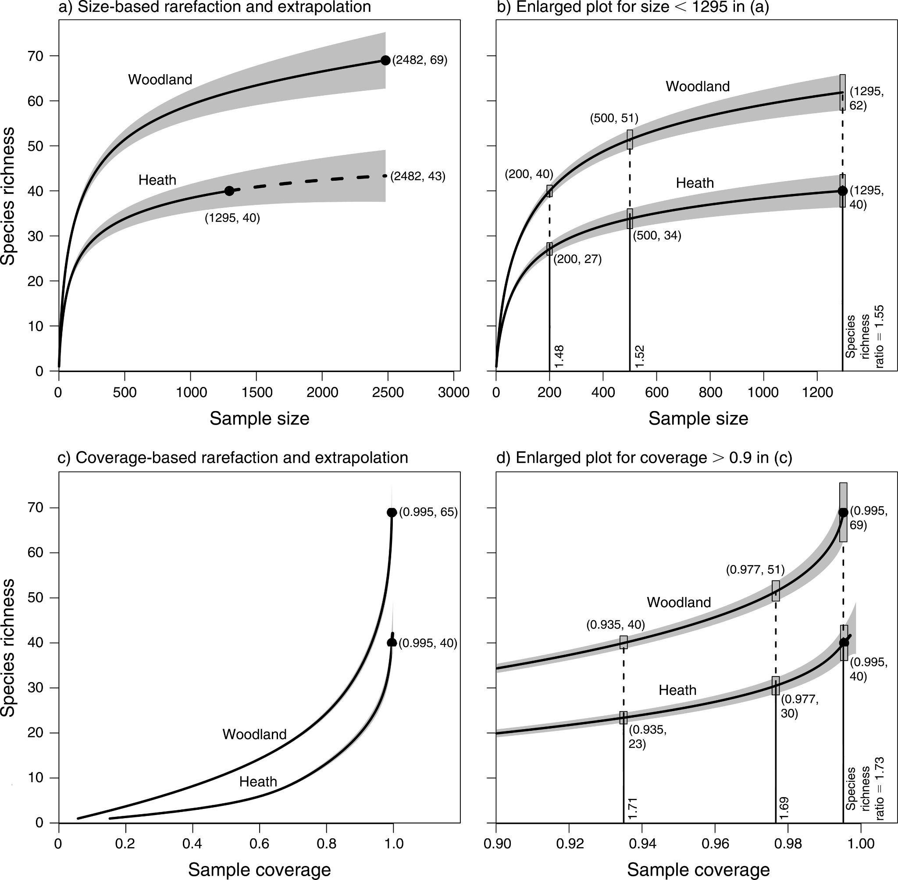
Coverage based rarefaction
Chao & Jost, 2012

Slide 14
Exercise 6 – Coverage based rarefaction
Go through the 6_exercise_coverage.R script in the Github repository

Slide 15
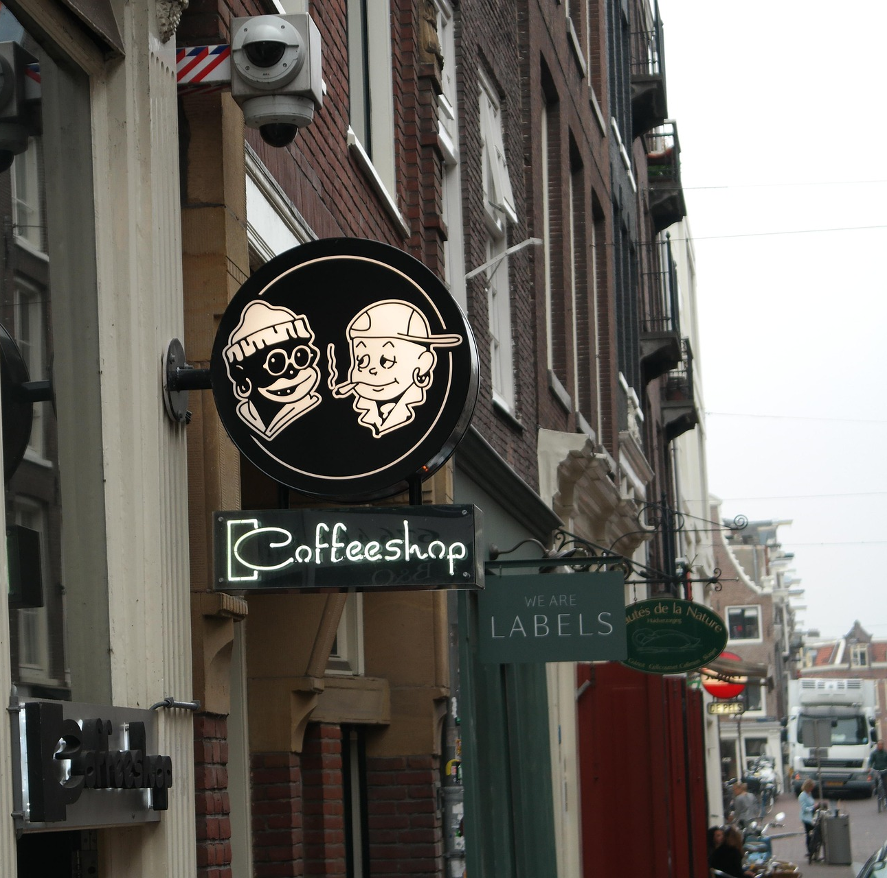
Spatial thinning
Everything is related to everything else, but near things are more related than distant things

Slide 16
Spatial thinning
Spatial autocorrelation
Things that are close together are usually more similar than things that are far apart
Individual data points are not independent piece of evidence
But most Golems belief so → overfitting
Spatial thinning as ad hoc solution

Slide 17
Spatial thinning

Slide 18
Spatial thinning

Slide 19
Spatial thinning
https://cran.r-project.org/web/packages/GeoThinneR/vignettes/GeoThinneR.html

Slide 20
But are we not loosing data?

Slide 21
Criticism – Sample standardisation
Standardization methods like rarefaction throw away perfectly good data
This sacrifices statistical power and increases uncertainty
We are no longer in control of the Golem
We need to trust pre-specified tools and algorithms
The Golem can not learn about the real world
Variation in sampling effort isn't a nuisance; it's part of the generative process
No information transfer
The better solution is to build the sampling process into our model

Slide 22
Summary
Sampling effort is heterogenic
Same places are better sampled, some less
Methods like rarefaction, bootstrapping and coverage based rarefaction can solve this (to some degree …)
Nearby samples tend to be more similar
Spatially-autocorrelated samples are not independent, leading to overfitting
Can be solved by spatial thinning
All these approaches throw away data and do not allow information transfer
Instead, we should build a smarter model that fits the data's reality

